Slide 1
Structural Testing

Slide 2
Learning objectives
Understand rationale for structural testing
  How structural (code-based or glass-box) testing complements functional (black-box) testing
Recognize and distinguish basic terms
  Adequacy, coverage
Recognize and distinguish characteristics of common structural criteria
Understand practical uses and limitations of structural testing

Slide 3
“Structural” testing
Judging test suite thoroughness based on the structure of the program itself
  Also known as “white-box”, “glass-box”, or “code-based” testing
  To distinguish from functional (requirements-based, “black-box” testing)
      “Structural” testing is still testing product functionality against its specification. Only the measure of thoroughness has changed.
Notes:
What do we mean by “structural” testing?
Note that this is only a distinction in how we judge thoroughness.
Structural testing, just like functional (spec-based) testing, still
requires program specifications of some kind to judge whether
a test execution was correct.

Slide 4
Why structural (code-based) testing?
One way of answering the question “What is missing in our test suite?”
  If part of a program is not executed by any test case in the suite, faults in that part cannot be exposed
  But what’s a “part”?
    Typically, a control flow element or combination:
    Statements (or CFG nodes), Branches (or CFG edges)
    Fragments and combinations: Conditions, paths
Complements functional testing: Another way to recognize cases that are treated differently
  Recall fundamental rationale: Prefer test cases that are treated differently over cases treated the same
Notes:
The fundamental rationale for any systematic (non-random) testing technique is
variation: Testing something different is more valuable than testing the same
thing again. There are many ways to consider “same” and “different”, and we
find value in any sense of “different” that might reveal faults that were not
revealed by other test cases. Functional testing uses the program specification
to say what is “different” (systematically covering cases that can be identified
in the specification). Structural testing

Slide 5
No guarantees
Executing all control flow elements does not guarantee finding all faults
  Execution of a faulty statement may not always result in a failure
    The state may not be corrupted when the statement is executed with some data values
    Corrupt state may not propagate through execution to eventually lead to failure
What is the value of structural coverage?
  Increases confidence in thoroughness of testing
    Removes some obvious inadequacies
Notes:
Structural testing provides a basic check: Did we completely leave miss
something that should have been tested? It doesn’t guarantee that the
test cases we chose were good.
Despite the limitation, it’s valuable because a good test designer does not
just blindly satisfy a structural coverage criterion. Structural criteria serve
as reminders to think carefully about what has been missed, and choose
good test cases for the underlying difference in treatment by the program.

Slide 6
Structural testing complements functional testing
Control flow testing includes cases that may not be identified from specifications alone
  Typical case: implementation of a single item of the specification by multiple parts of the program
  Example: hash table collision (invisible in interface spec)
Test suites that satisfy control flow adequacy criteria could fail in revealing faults that can be caught with functional criteria
  Typical case: missing path faults

Slide 7
Structural testing in practice
Create functional test suite first, then measure structural coverage to identify see what is missing
Interpret unexecuted elements
  may be due to natural differences between specification and implementation
  or may reveal flaws of the software or its development process
    inadequacy of specifications that do not include cases present in the implementation
    coding practice that radically diverges from the specification
    inadequate functional test suites
Attractive because automated
  coverage measurements are convenient progress indicators
  sometimes used as a criterion of completion
    use with caution: does not ensure effective test suites

Slide 8
Statement testing
Adequacy criterion: each statement (or node in the CFG) must be executed at least once
Coverage:
# executed statements
# statements
Rationale: a fault in a statement can only be revealed by executing the faulty statement
Notes:
12.2 STATEMENT TESTING

Slide 9
Statements or blocks?
Nodes in a control flow graph often represent basic blocks of multiple statements
  Some standards refer to basic block coverage or node coverage
  Difference in granularity, not in concept
No essential difference
  100% node coverage <-> 100% statement coverage
    but levels will differ below 100%
  A test case that improves one will improve the other
    though not by the same amount, in general

Slide 10
Example
T₀ =
{“”, “test”,
“test+case%1Dadequacy”}
17/18 = 94% Stmt Cov.
T₁ =
{“adequate+test%0Dexecution%7U”}
18/18 = 100% Stmt Cov.
T₂ =
{“%3D”, “%A”, “a+b”,
“test”}
18/18 = 100% Stmt Cov.
Notes:
T0, T1, T2 are test suites (sets of test cases)
In T0 (2 test cases):
“” covers nodes A, B, M
“test+case%1Dadequacy” covers nodes
A, B, C, D, F, L, ... B, C, E, L, ..., B, C, D, G, H, L, ... B, M
In T1 (one test case):
“adequate+test%0Dexecution%7U” covers nodes
A, B, C, D, F, L, ... B, C, E, L, ..., B, C, D, G, H, L, ... B, C, D, G, I, L, ... B, M
In T2 (4 test cases):
“%3D” covers A, B, C, D, G, H, L, B, M
“%A” covers A, B, C, D, G, I, L, B, M
“a+b” covers A, B, C, D, F, L, M, B, C, E, L, ...
“test” covers A, B, C, D, F, L, ..., M

Slide 11
Coverage is not size
Coverage does not depend on the number of test cases
  T₀ , T₁ : T₁ >_{coverage} T₀ T₁ <_{cardinality} T₀
  T₁ , T₂ : T₂ =_{coverage} T₁ T₂ >_{cardinality} T₁
Minimizing test suite size is seldom the goal
  small test cases make failure diagnosis easier
  a failing test case in T₂ gives more information for fault localization than a failing test case in T₁

Slide 12
“All statements” can miss some cases
Complete statement coverage may not imply executing all branches in a program
Example:
  Suppose block F were missing
  Statement adequacy would not require false branch from D to L
T₃ =
{“”, “+%0D+%4J”}
100% Stmt Cov.
No false branch from D
Notes:
12.3 BRANCH TESTING

Slide 13
Branch testing
Adequacy criterion: each branch (edge in the CFG) must be executed at least once
Coverage:
# executed branches
# branches
  T₃ = {“”, “+%0D+%4J”}
  100% Stmt Cov. 88% Branch Cov. (7/8 branches)
  T₂ = {“%3D”, “%A”, “a+b”, “test”}
  100% Stmt Cov. 100% Branch Cov. (8/8 branches)

Slide 14
Statements vs branches
Traversing all edges of a graph causes all nodes to be visited
  So test suites that satisfy the branch adequacy criterion for a program P also satisfy the statement adequacy criterion for the same program
The converse is not true (see T₃)
  A statement-adequate (or node-adequate) test suite may not be branch-adequate (edge-adequate)
Notes:
The example of two slides ago illustrates this point

Slide 15
“All branches” can still miss conditions
Sample fault: missing operator (negation)
digit_high == 1 || digit_low == -1
Branch adequacy criterion can be satisfied by varying only digit_low
  The faulty sub-expression might never determine the result
  We might never really test the faulty condition, even though we tested both outcomes of the branch
Notes:
Recall we’re trying to exercise each of the significant cases in the code. A single
branch statement (“if”, “while”, etc.) may actually combine different cases in a
complex condition, and exercising both outcomes of the branch may not exercise
each part of the complex condition.

Slide 16
Condition testing
Branch coverage exposes faults in how a computation has been decomposed into cases
  intuitively attractive: check the programmer’s case analysis
  but only roughly: groups cases with the same outcome
Condition coverage considers case analysis in more detail
  also individual conditions in a compound Boolean expression
    e.g., both parts of digit_high == 1 || digit_low == -1
Notes:
12.4 CONDITION TESTING

Slide 17
Basic condition testing
Adequacy criterion: each basic condition must be executed at least once
Coverage:
# truth values taken by all basic conditions
2 * # basic conditions
Notes:
the total number of truth values that the basic conditions can take is twice the number of basic conditions, since each basic condition can assume value true or false

Slide 18
Basic conditions vs branches
Basic condition adequacy criterion can be satisfied without satisfying branch coverage
T4 = {“first+test%9Ktest%K9”}
satisfies basic condition adequacy
does not satisfy branch condition adequacy
Branch and basic condition are not comparable
(neither implies the other)
Notes:
Unlike branches and statements (where covering all branches was enough to also cover all statements),
covering all basic conditions does not replace covering all branches.

Slide 19
Covering branches and conditions
Branch and condition adequacy:
  cover all conditions and all decisions
Compound condition adequacy:
  Cover all possible evaluations of compound conditions
  Cover all branches of a decision tree
Notes:
Notice that due to the left-to-right evaluation order and short-circuit evaluation of logical OR expressions in the C language, the value true for the first condition does not need to be combined with both values false and true for the second condition.

Slide 20
Compound conditions:
Exponential complexity
(((a || b) && c) || d) && e
Test a b c d e
Case
(1) T — T — T
(2) F T T — T
(3) T — F T T
(4) F T F T T
(5) F F — T T
(6) T — T — F
(7) F T T — F
(8) T — F T F
(9) F T F T F
(10) F F — T F
(11) T — F F —
(12) F T F F —
(13) F F — F —
short-circuit evaluation often reduces this to a more manageable number, but not always
Notes:
Why do we care? Because even one very complex condition in a program could require
an impractical number of test cases. For example, a condition with 16 basic conditions
could require more than 32,000 test cases (although this is unlikely in practice, because
very large conditions are more typically just one big disjunction or one big conjunction,
which are effectively reduced to a linear number of cases by short-circuit evaluation).

Slide 21
Modified condition/decision (MC/DC)
Motivation: Effectively test important combinations of conditions, without exponential blowup in test suite size
  “Important” combinations means: Each basic condition shown to independently affect the outcome of each decision
Requires:
  For each basic condition C, two test cases,
  values of all evaluated conditions except C are the same
  compound condition as a whole evaluates to true for one and false for the other
Notes:
If we don’t want to test all possible combinations, then we have to say which combinations are important.
One good choice is to choose combinations that show how each basic condition can affect the outcome,
i.e., how changing that one condition can change the value of the whole compound condition. That’s
what the “modified condition/decision” criterion requires.

Slide 22
MC/DC: linear complexity
N+1 test cases for N basic conditions
(((a || b) && c) || d) && e
Test a b c d e outcome
Case
(1) true -- true -- true true
(2) false true true -- true true
(3) true -- false true true true
(6) true -- true -- false false
(11) true -- false false -- false
(13) false false -- false -- false
Underlined values independently affect the output of the decision
Required by the RTCA/DO-178B standard
Notes:
This is the same table as two slides ago, omitting redundant cases.
Cases 4,5, 7-10, and 12 have been omitted.
In each column we find two rows in which that column is underlined. For example, the “a” column
is underlined in rows (1) and (13). All the evaluated conditions in those two rows are the same
except for that column. For example, to show that changing “a” from true to false in case (1) would
change the outcome, we
* Fill in the “don’t care” columns in row 1 with values from row 13 (because this doesn’t change
anything
* Then see that the rows are completely identical except in column “a” and the outcome
so clearly changing the value of “a” changed the outcome.
The number of test cases needed is hardly more than for basic condition coverage, but MC/DC is
much better than basic condition coverage at exposing faults in conditional expressions, so it is
clearly superior (and therefore very widely used, and specified in some standards).

Slide 23
Comments on MC/DC
MC/DC is
  basic condition coverage (C)
  branch coverage (DC)
  plus one additional condition (M):
  every condition must independently affect the decision’s output
It is subsumed by compound conditions and subsumes all other criteria discussed so far
  stronger than statement and branch coverage
A good balance of thoroughness and test size (and therefore widely used)
Notes:
(This mainly restates comments on the previous slide, and can be used
or skipped depending on lecture style)

Slide 24
Paths? (Beyond individual branches)
Should we explore sequences of branches (paths) in the control flow?
Many more paths than branches
  A pragmatic compromise will be needed

Slide 25
Path adequacy
Decision and condition adequacy criteria consider individual program decisions
Path testing focuses consider combinations of decisions along paths
Adequacy criterion: each path must be executed at least once
Coverage:
# executed paths
# paths
Notes:
12.5 PATH TESTING
Path coverage simply requires each path to be executed at least once, thus helping in revealing failures that occur when loops are executed several times. Unfortunately, “pure” path coverage is impractical even for simple programs (the program on the slide has infinite many paths). An easy way to reduce the number of paths is to limit the number of times of executions of each loop.

Slide 26
Practical path coverage criteria
The number of paths in a program with loops is unbounded
  the simple criterion is usually impossible to satisfy
For a feasible criterion: Partition infinite set of paths into a finite number of classes
Useful criteria can be obtained by limiting
  the number of traversals of loops
  the length of the paths to be traversed
  the dependencies among selected paths
Notes:
12.5 PATH TESTING
Path coverage simply requires each path to be executed at least once, thus helping in revealing failures that occur when loops are executed several times. Unfortunately, “pure” path coverage is impractical even for simple programs with loops. To ensure a finite number of paths, we must at least limit the number of times of executions of each loop (e.g., lump “5 iterations” and “105 iterations” in the same class “more than 1 iteration”, requiring only one representative execution from that class).

Slide 27
Boundary interior path testing
Group together paths that differ only in the subpath they follow when repeating the body of a loop
  Follow each path in the control flow graph up to the first repeated node
  The set of paths from the root of the tree to each leaf is the required set of subpaths for boundary/interior coverage

Slide 28
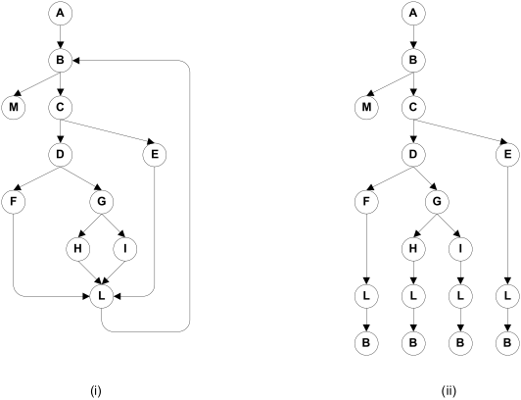
Boundary interior adequacy for cgi-decode
Notes:
The graph at the right shows the paths that must be covered in the control flow graph at the left, using the “boundary interior”
adequacy criiterion.

Slide 29
Limitations of boundary interior adequacy
The number of paths can still grow exponentially
if (a) {
S1;
}
if (b) {
S2;
}
if (c) {
S3;
}
...
if (x) {
Sn;
}
The subpaths through this control flow can include or exclude each of the statements Si, so that in total N branches result in 2^{N} paths that must be traversed
Choosing input data to force execution of one particular path may be very difficult, or even impossible if the conditions are not independent

Slide 30
Loop boundary adequacy
Variant of the boundary/interior criterion that treats loop boundaries similarly but is less stringent with respect to other differences among paths
Criterion: A test suite satisfies the loop boundary adequacy criterion iff for every loop:
  In at least one test case, the loop body is iterated zero times
  In at least one test case, the loop body is iterated once
  In at least one test case, the loop body is iterated more than once
Corresponds to the cases that would be considered in a formal correctness proof for the loop

Slide 31
LCSAJ adequacy
Linear Code Sequence And Jumps:
sequential subpath in the CFG starting and ending in a branch
  TER₁ = statement coverage
  TER₂ = branch coverage
  TER_{n+2} = coverage of n consecutive LCSAJs
Notes:
Considering the exponential blowup in sequences of conditional statements (even when not in loops),
we might choose to consider only sub-sequences of a given length. This is what LCSAJ gives us ---
essentially considering full path coverage of (short) sequences of decisions.
(Note: Data flow criteria considered in a later chapter provide a more principled way of choosing
some particular sub-paths as important enough to cover in testing. Neither LCSAJ nor
data flow criteria are much used in current practice.)

Slide 32
Cyclomatic adequacy
Cyclomatic number:
number of independent paths in the CFG
  A path is representable as a bit vector, where each component of the vector represents an edge
  “Dependence” is ordinary linear dependence between (bit) vectors
If e = #edges, n = #nodes, c = #connected components of a graph, it is:
  e - n + c for an arbitrary graph
  e - n + 2 for a CFG
Cyclomatic coverage counts the number of independent paths that have been exercised, relative to cyclomatic complexity
Notes:
There is nothing deep to be grasped here about linearly independent paths, but cyclomatic complexity is
used in industry for test planning (estimating testing effort) and sometimes as an adequacy measure. Its
attractions are that cyclomatic complexity serves as a simple, rough estimate of the complexity of code,
and it requires more testing effort for code with complex control flow than for code with simple control
flow. “Linear independence” requires some differences between test cases that can be counted toward
thorough testing, even if it is not closely related to the programmer’s case analysis.

Slide 33
Towards procedure call testing
The criteria considered to this point measure coverage of control flow within individual procedures.
  not well suited to integration or system testing
Choose a coverage granularity commensurate with the granularity of testing
  if unit testing has been effective, then faults that remain to be found in integration testing will be primarily interface faults, and testing effort should focus on interfaces between units rather than their internal details
Notes:
12.6 PROCEDURE CALL TESTING

Slide 34
Procedure call testing
Procedure entry and exit testing
  procedure may have multiple entry points (e.g., Fortran) and multiple exit points
Call coverage
  The same entry point may be called from many points

Slide 35
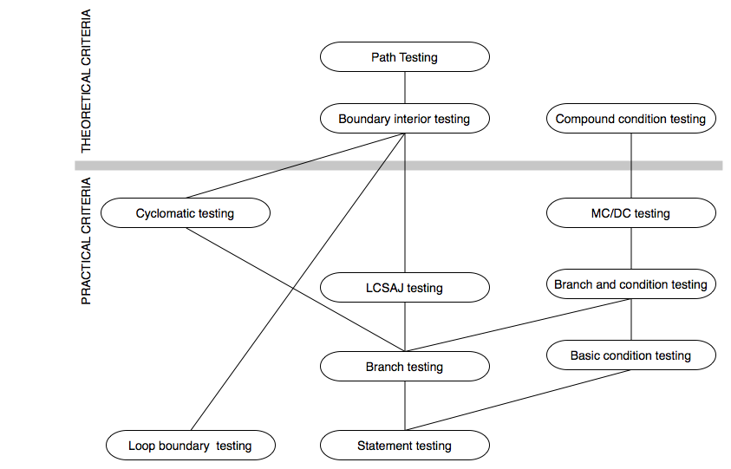
Subsumption relation
Notes:
NOTE: This diagram is revised (corrected) from the version that appears in the book ---
the position of “loop boundary testing” has been changed to properly reflect the definition
given in the book.
12.7 COMPARING STRUCTURAL TESTLING CRIETERIA
See Chapter 9 for the definition of subsumption
The criteria above the bar are of theoretical interest, but can require
either an exponential number of test cases relative to program size
(compound condition testing, boundary interior testing) or a
potentially infinite number of test cases (path testing).
The criteria below the bar are “practical” in the sense that the number
of test cases they require, even in the worst case, is only linear in
program size, and all of them have been used in industrial practice.
Since MC/DC and loop boundary testing are mutually incomparable, and
since each is closely tied to program logic (reflecting the case analysis
that a programmer must consider to write and justify the code), they are
an attractive combination.

Slide 36
Satisfying structural criteria
Sometimes criteria may not be satisfiable
  The criterion requires execution of
    statements that cannot be executed as a result of
      defensive programming
      code reuse (reusing code that is more general than strictly required for the application)
    conditions that cannot be satisfied as a result of
      interdependent conditions
    paths that cannot be executed as a result of
      interdependent decisions
Notes:
12.8 THE INFEASIBILITY PROBLEM

Slide 37
Satisfying structural criteria
Large amounts of fossil code may indicate serious maintainability problems
  But some unreachable code is common even in well-designed, well-maintained systems
Solutions:
  make allowances by setting a coverage goal less than 100%
  require justification of elements left uncovered
    RTCA-DO-178B and EUROCAE ED-12B for modified MC/DC
Notes:
12.8 THE INFEASIBILITY PROBLEM

Slide 38
Summary
We defined a number of adequacy criteria
  NOT test design techniques!
Different criteria address different classes of errors
Full coverage is usually unattainable
  Remember that attainability is an undecidable problem!
…and when attainable, “inversion” is usually hard
  How do I find program inputs allowing to cover something buried deeply in the CFG?
  Automated support (e.g., symbolic execution) may be necessary
Therefore, rather than requiring full adequacy, the “degree of adequacy” of a test suite is estimated by coverage measures
  May drive test improvement

